Slide 1
Institutional Innovation in Cyber Security – A multilevel computational model
Russell C. Thomas
russell.thomas@meritology.com
@MrMeritology
Blog: Exploring Possibility Space

Slide 2
Institutional Innovation??
(Radical) alternatives to cyber insurance
Information sharing, reporting, inspection
Risk scoring, rating, and reporting
…

Slide 3
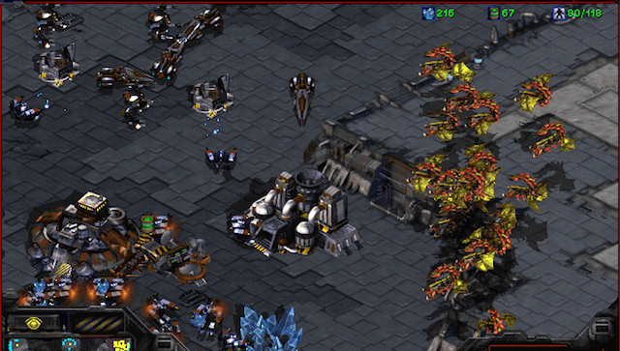
Role Model: StarCraft BroodWar

Slide 4
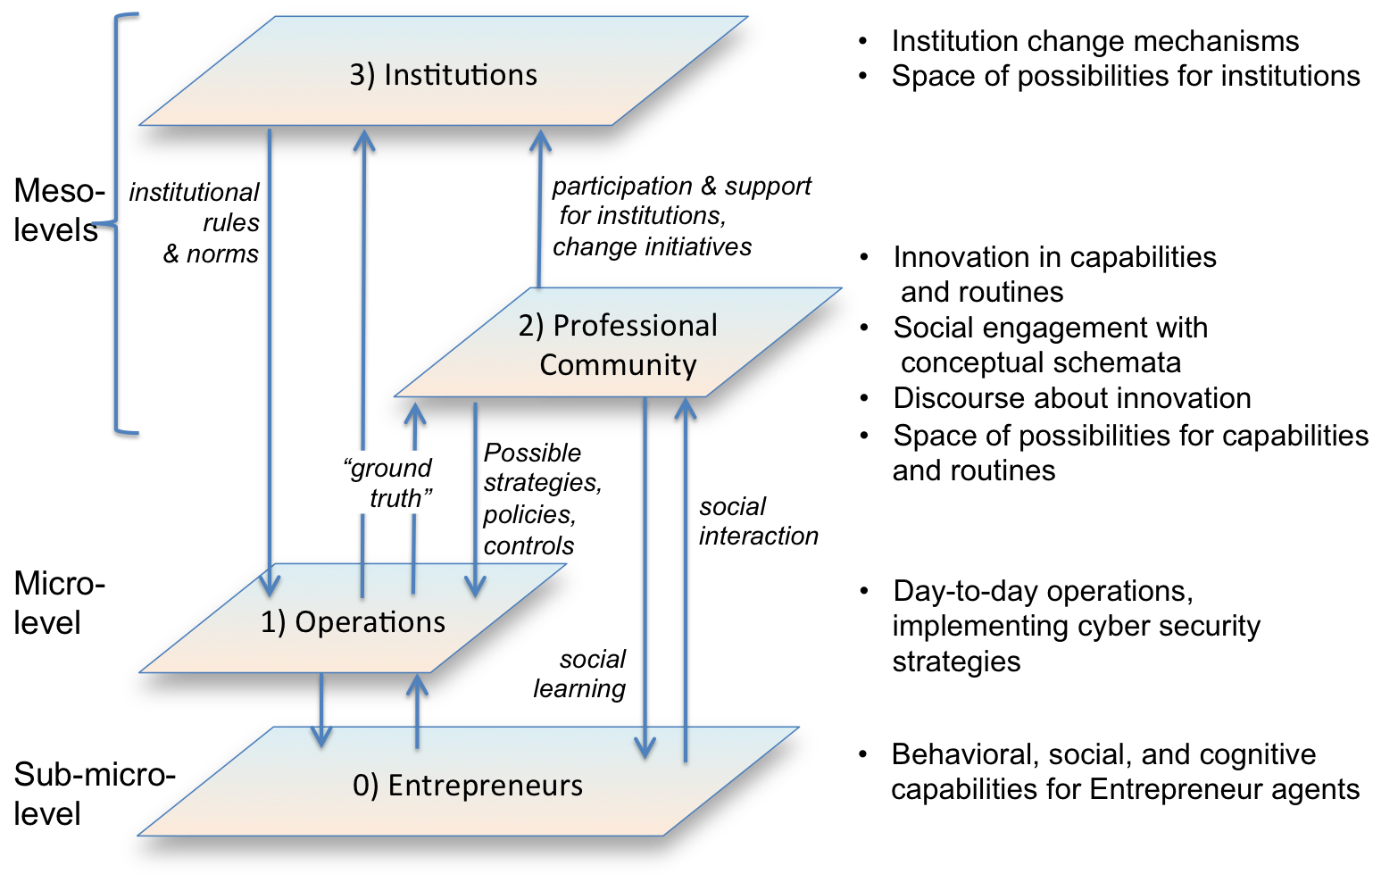

Slide 5
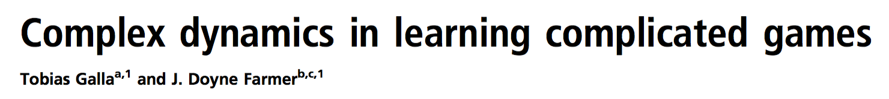
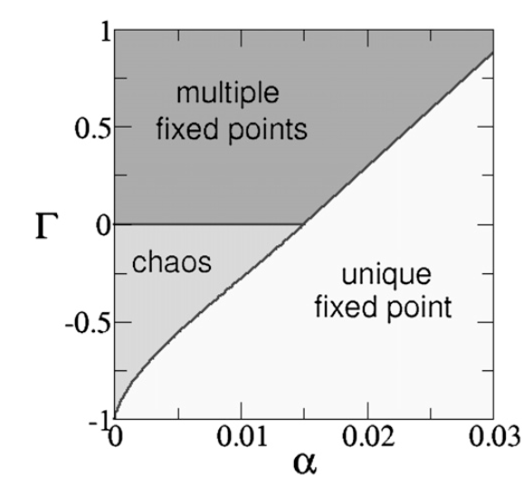
Foundation: Random Complicated Games with Experience-weighted Learning

Slide 6
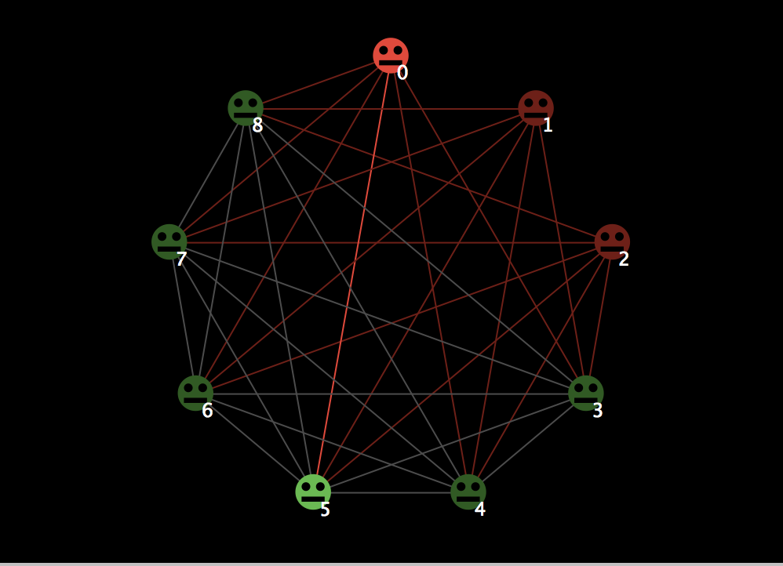

Slide 7
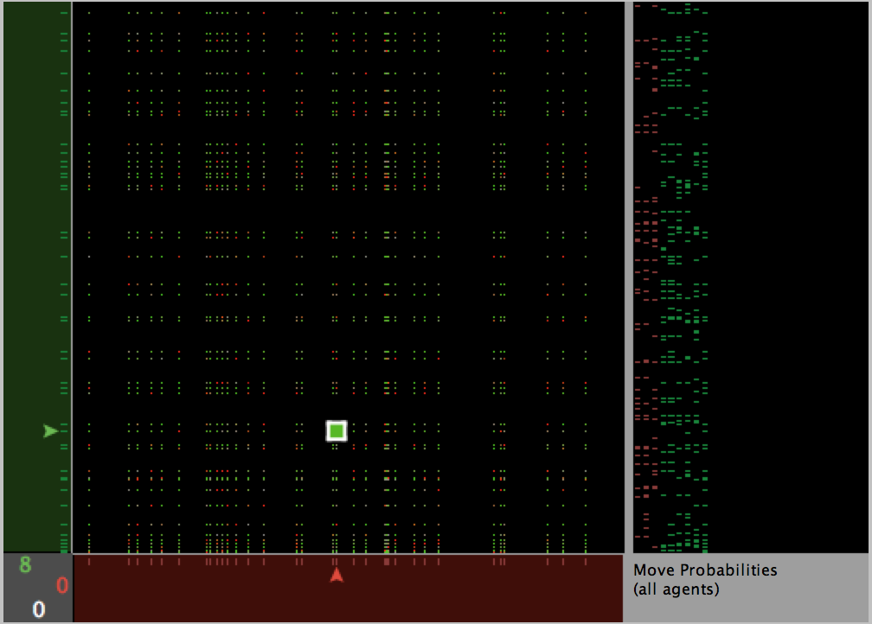

Slide 8
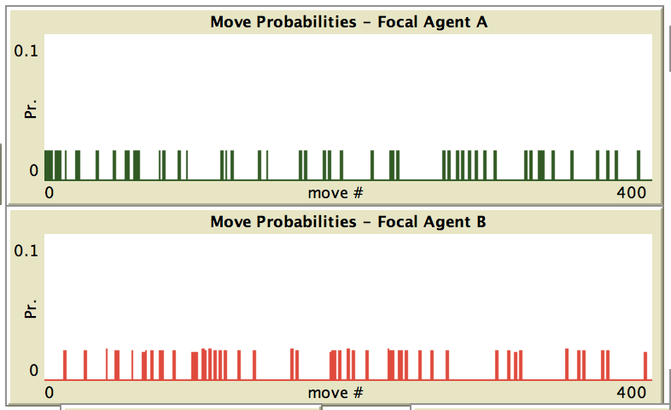
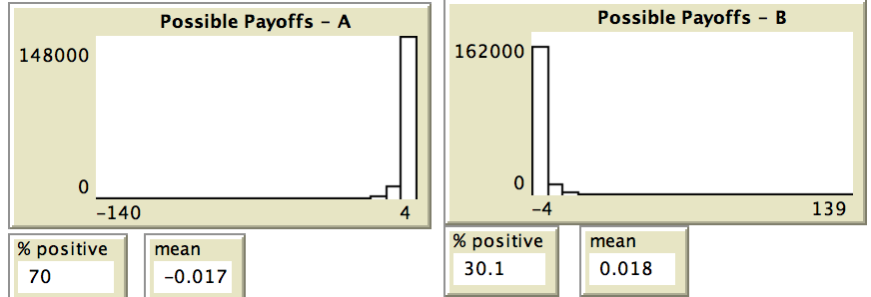
t = 0

Slide 9
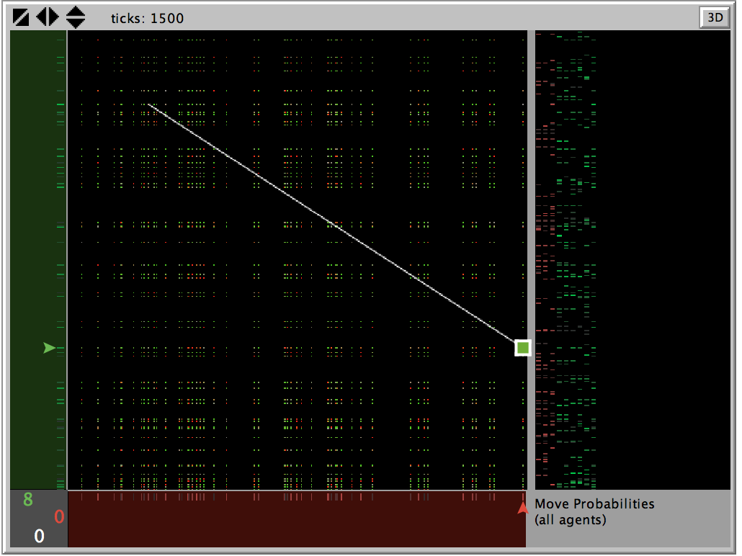

Slide 10
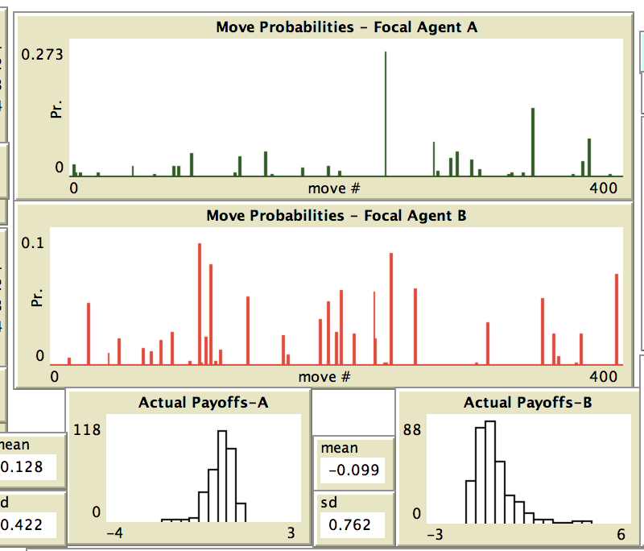
t = 1500

Slide 11
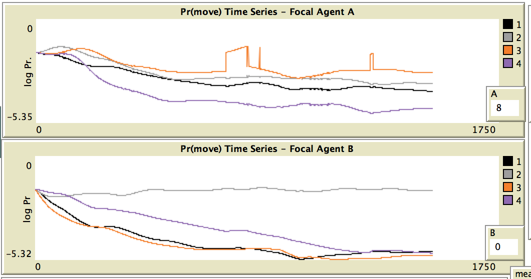
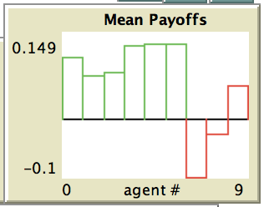

Slide 12
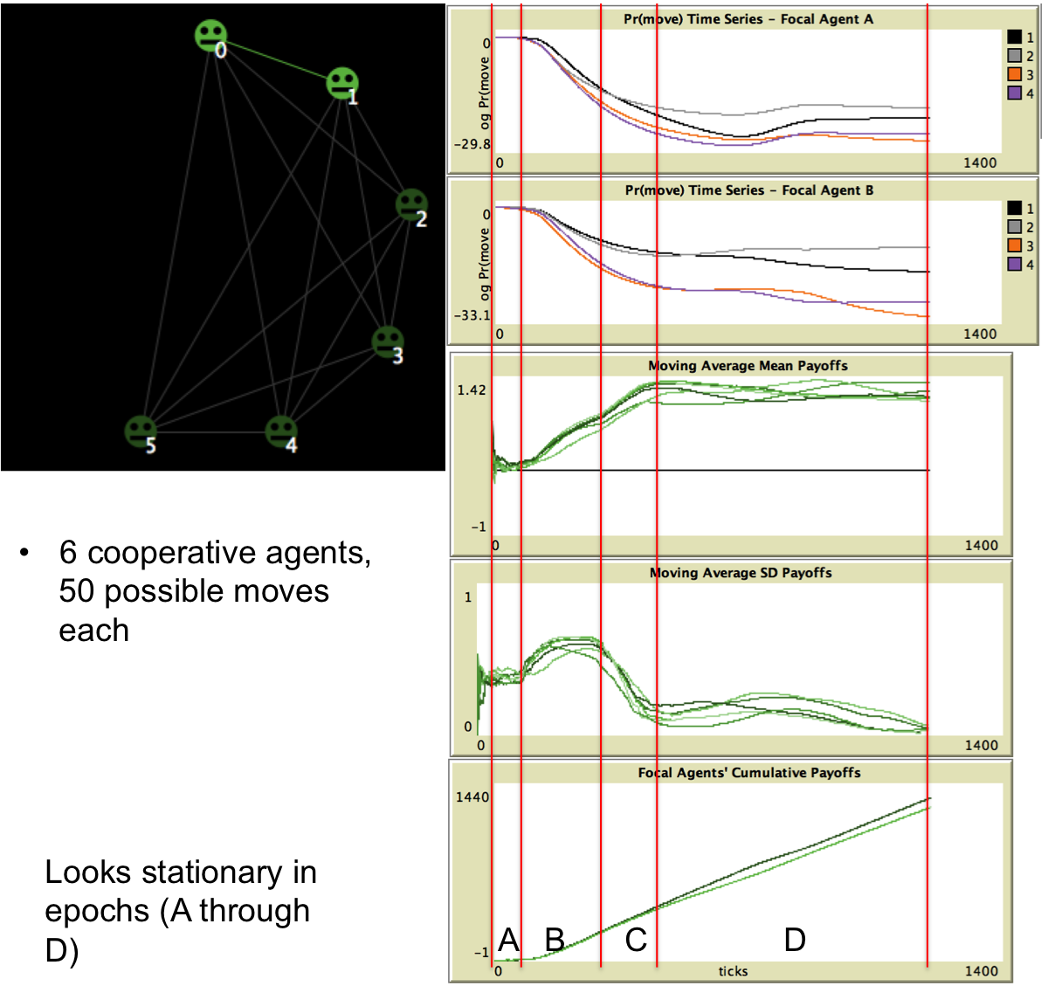
FIXED
POINT
(Equilibrium)

Slide 13
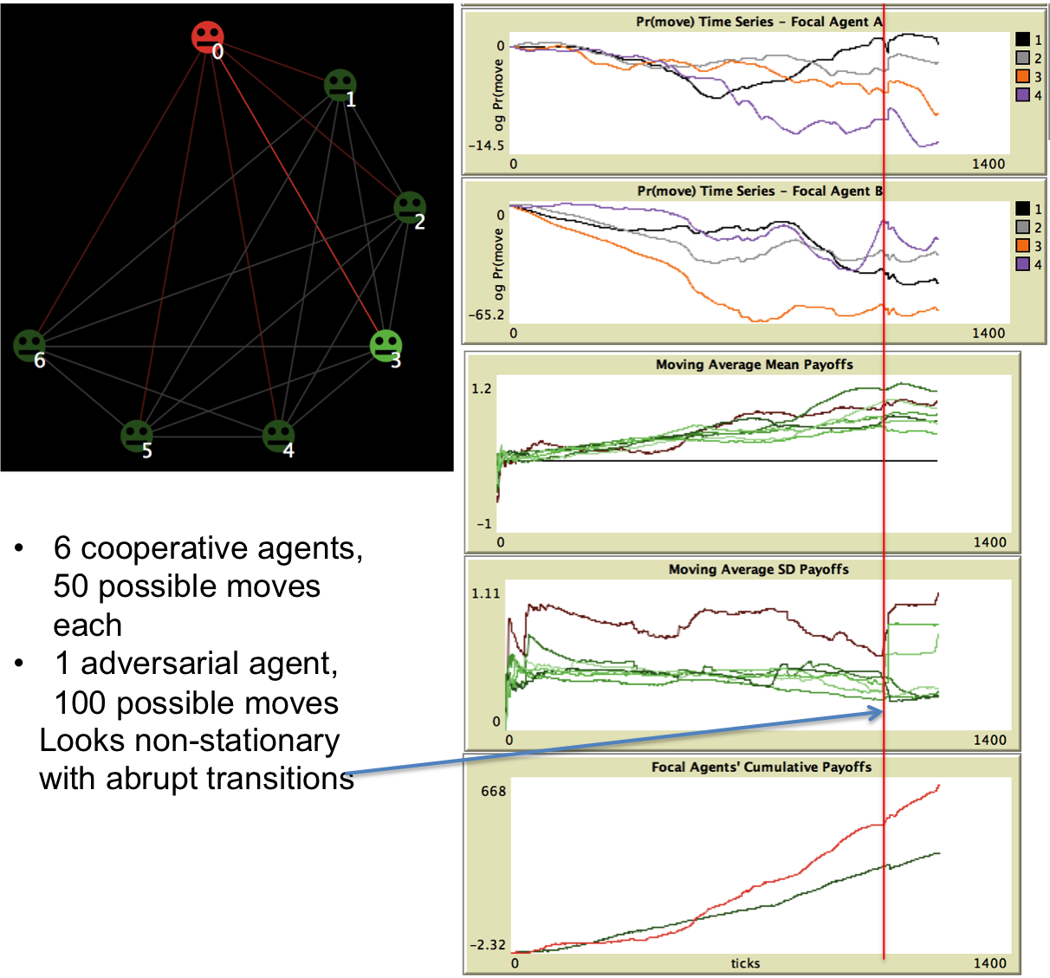
Chaos
(No Equilibrium)

Slide 14
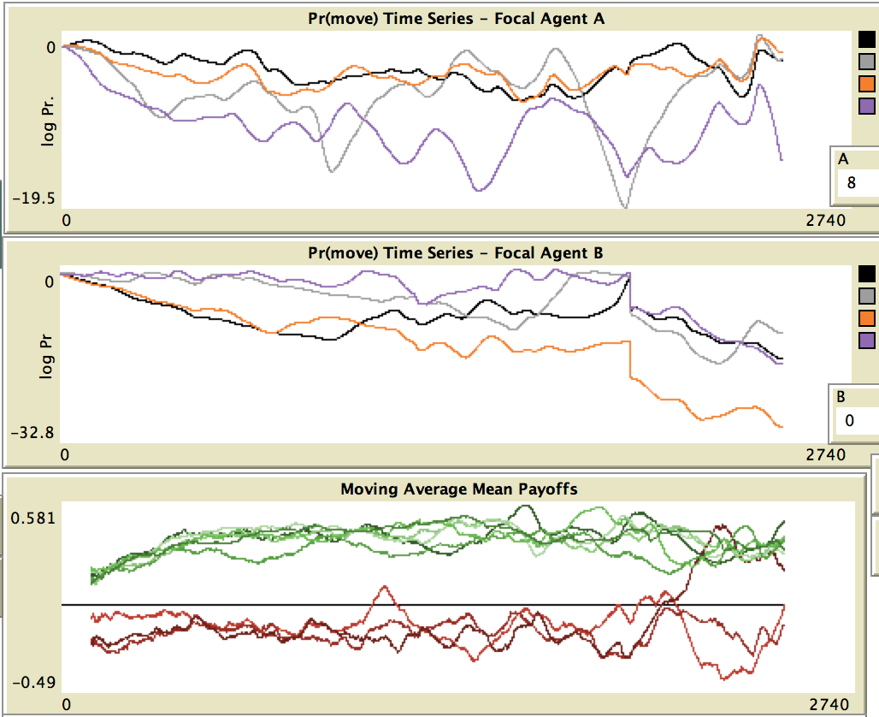
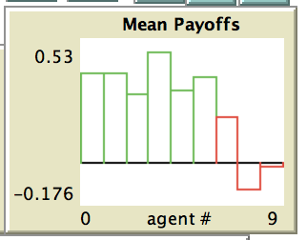
Treatment: Novelty (Red)
t = 2500
Regime Change
One Attacker Starts to Thrive
Green Agents Dominate Initially

Slide 15
Other Treatments & Institutions
Varieties of ignorance, error, and uncertainty
Social imitation, information sharing, and “best practices”
Investment policies: two levels
Capabilities
Infrastructure
Host-parasite dynamics
Incentive instruments (incl. insurance)

Slide 16
Russell C. Thomas
russell.thomas@meritology.com
@MrMeritology
Blog: Exploring Possibility Space

